Slide 1
Sentiment Analysis of IMDB Reviews
Group 43:
Abhiram ravipati – A20539084
Divya kampalli – A20539479
Sumanth kalyan bandigupthapu – A20544342

Slide 2
Introduction
Sentiment analysis is an essential application of Machine Learning (ML) and Natural Language Processing (NLP) that focuses on determining whether a given text expresses a positive, negative, or neutral sentiment. In this project, we aim to classify sentiments in IMDB movie reviews, leveraging advanced machine learning techniques to achieve accurate predictions.
Objective:
The main objective of this project is to classify IMDB movie reviews as either positive or negative. By achieving this, we aim to gain meaningful insights into audience sentiments, which can help improve movie recommendation systems, marketing strategies, and customer satisfaction analyses.

Slide 3
Dataset Description
The dataset used in this project is the IMDB Movie Reviews Dataset. It consists of 50,000 movie reviews, with each review labeled as either positive or negative, making it a balanced dataset with 25,000 reviews in each category. Each entry includes the review text, written in natural language, and its corresponding sentiment label. Sourced from IMDB, this dataset is highly relevant for understanding real-world audience sentiments and provides an excellent foundation for training and evaluating machine learning models in the field of Natural Language Processing.

Slide 4
Data Preprocessing
Noise Removal: Removed HTML tags, special characters, and numbers.
Text Normalization: Converted text to lowercase for uniformity.
Stop Word Removal: Excluded generic stop words (e.g., "the", "and") and domain-specific words (e.g., "movie", "film").
Lemmatization: Reduced words to their base forms (e.g., "running" → "run").
Targeted Cleaning : Removed irrelevant words like "people", "much", and "thing" to enhance sentiment differentiation.
These steps ensured clean, high-quality data for effective model training and analysis.

Slide 5
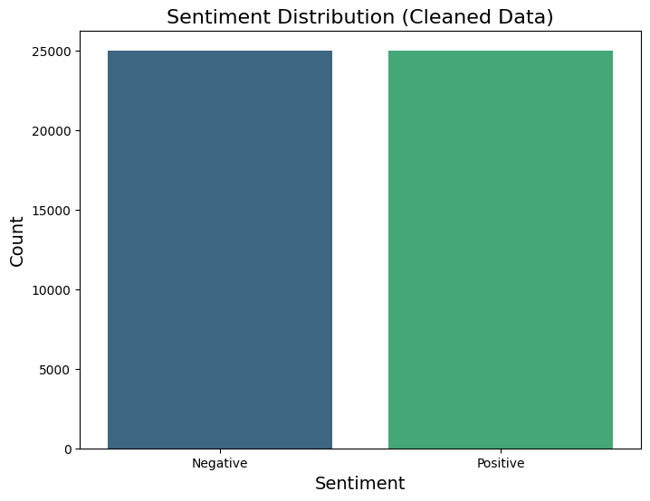
Exploratory Data Analysis

Slide 6
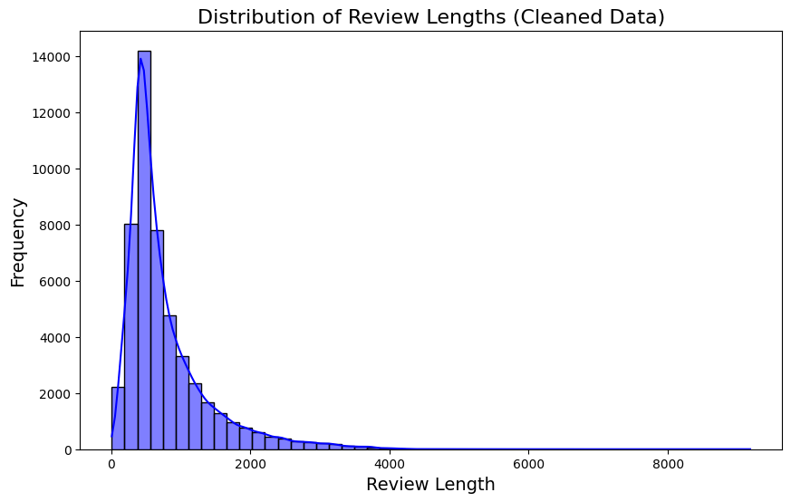
Exploratory Data Analysis

Slide 7
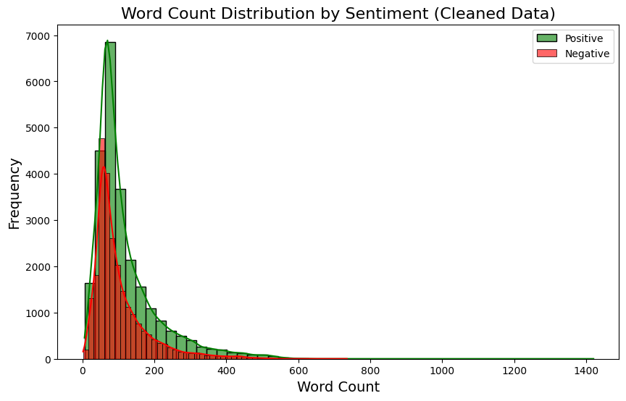
Exploratory Data Analysis

Slide 8
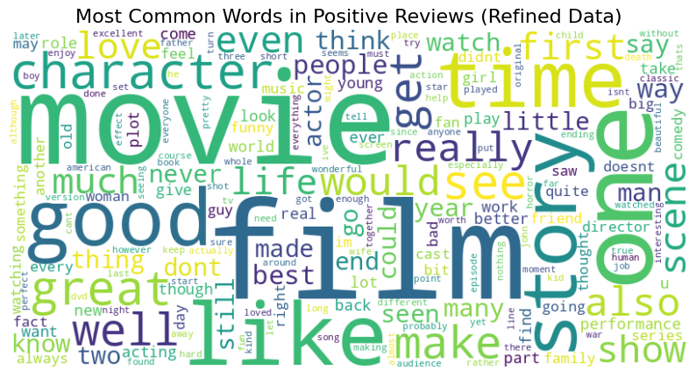
Exploratory Data Analysis

Slide 9
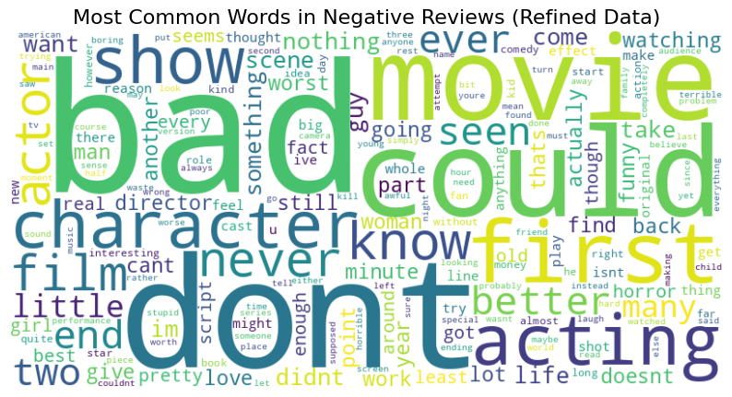
Exploratory Data Analysis

Slide 10
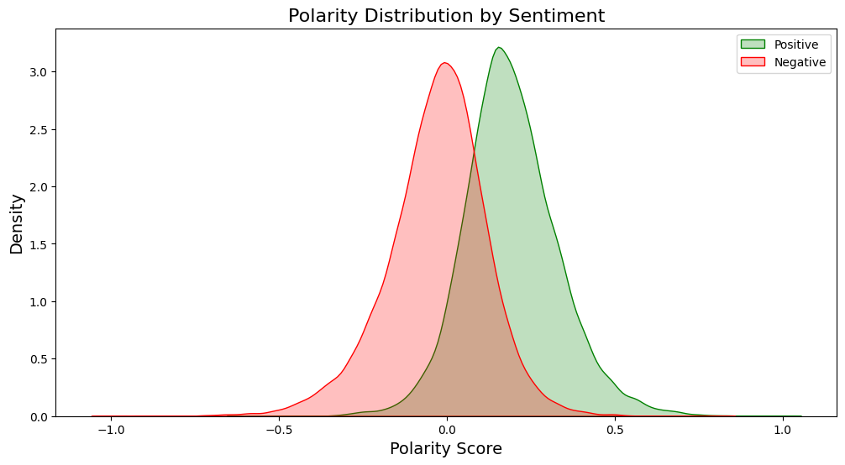
Exploratory Data Analysis

Slide 11
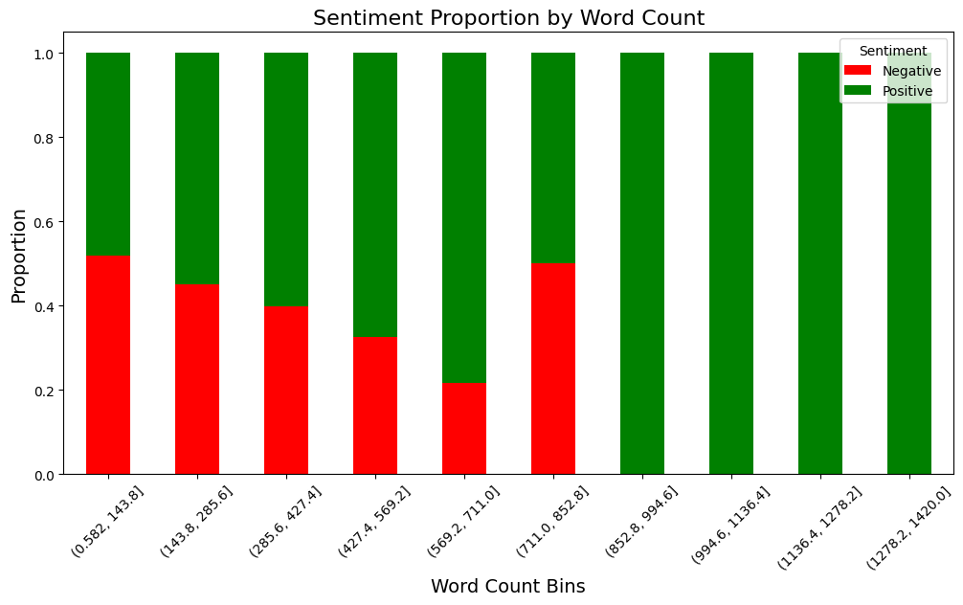
Exploratory Data Analysis

Slide 12
Model: Logistic Regression
Overview: Logistic Regression is a simple and efficient linear model widely used for binary classification tasks like sentiment analysis.
Why We Used: Logistic Regression is ideal for understanding the relationship between features and binary outcomes. Its simplicity, speed, and ability to work well with large datasets make it a strong baseline model for comparison.
Accuracy: 87.23%
Precision: 86.88%
Recall: 88.31%
F1-Score: 87.85%
Insights: Logistic Regression achieved the highest performance across all metrics, making it the best model for this dataset. Its simplicity and effectiveness highlight its suitability for text classification tasks.

Slide 13
Model: Random Forest
Overview: Random Forest is an ensemble learning method that combines multiple decision trees to improve classification accuracy and reduce overfitting.
Why We Used: Random Forest is robust to noise and overfitting. It is especially effective in capturing complex patterns in the data and handling imbalanced datasets.
Accuracy: 68.20%
Precision: 83.56%
Recall: 48.27%
F1-Score: 61.18%
Insights: Random Forest showed strong precision but struggled with recall, indicating it was conservative in predicting positive sentiments. Its overall accuracy was lower than expected for this dataset.

Slide 14
Model: Decision Tree
Overview: Decision Trees classify data based on feature splits. They are intuitive and visually interpretable but prone to overfitting.
Why We Used: Decision Trees are simple to understand and interpret, making them useful for visualizing decision rules and analyzing important features.
Accuracy: 67.67%
Precision: 68.65%
Recall: 69.44%
F1-Score: 69.09%
Insights: Decision Trees performed moderately well, but their tendency to overfit on the training data limited their effectiveness compared to ensemble methods.

Slide 15
Model: Naïve Bayes
Overview: Naive Bayes is a probabilistic classifier that assumes feature independence, making it efficient for large-scale text data.
Why We Used: Naive Bayes is computationally efficient and works well with high-dimensional data like text, making it a good choice for early benchmarks in text classification tasks.
Accuracy: 80.47%
Precision: 84.03 %
Recall: 77.22 %
F1-Score: 80.36 %
Insights: Naive Bayes delivered solid performance, particularly in precision, but slightly lagged in recall compared to Logistic Regression.

Slide 16
Model: Support Vector Machine
Overview: Linear Support Vector Machine is a high-dimensional linear classifier, ideal for text classification tasks.
Why We Used: SVM is effective in handling high-dimensional data and text classification tasks. It is robust and works well with both balanced and imbalanced datasets.
Accuracy: 86.87%
Precision: 87.02 %
Recall: 87.80 %
F1-Score: 87.41 %
Insights: SVM achieved results comparable to Logistic Regression, with high accuracy, precision, and recall. Its performance demonstrates its robustness for text classification tasks but at a higher computational cost.

Slide 17
Results
Logistic Regression emerged as the most effective model for this dataset, achieving the best balance between precision, recall, and F1-Score.
SVM provided similar performance but required higher computational effort.
Ensemble methods like Random Forest need additional tuning for text classification tasks.
Naive Bayes remains a strong contender for fast, scalable sentiment analysis.

Slide 18
Conclusion & Future Work
Conclusion:
This project successfully classified IMDB movie reviews into positive and negative sentiments using machine learning models, with Logistic Regression achieving the best performance (87.23% accuracy). Effective data preprocessing and the use of semi-supervised learning enhanced the model's accuracy, highlighting the importance of robust cleaning and innovative learning techniques in sentiment analysis.
Future Work:
Future improvements include exploring advanced models like BERT for better contextual understanding, expanding the dataset for generalization, and deploying the model in real-world applications, such as recommendation systems or sentiment dashboards, for practical insights.

Slide 19
Individual Contributions
Abhiram Ravipati: Data Collection, Modelling, Analysis of results
Divya Kampalli: Exploratory Data Analysis
Sumanth Kalyan Bandigupthapu: Data Pre-Processing

